Slide 1

Investing: A Student’s Perspective
March 2022

Slide 2
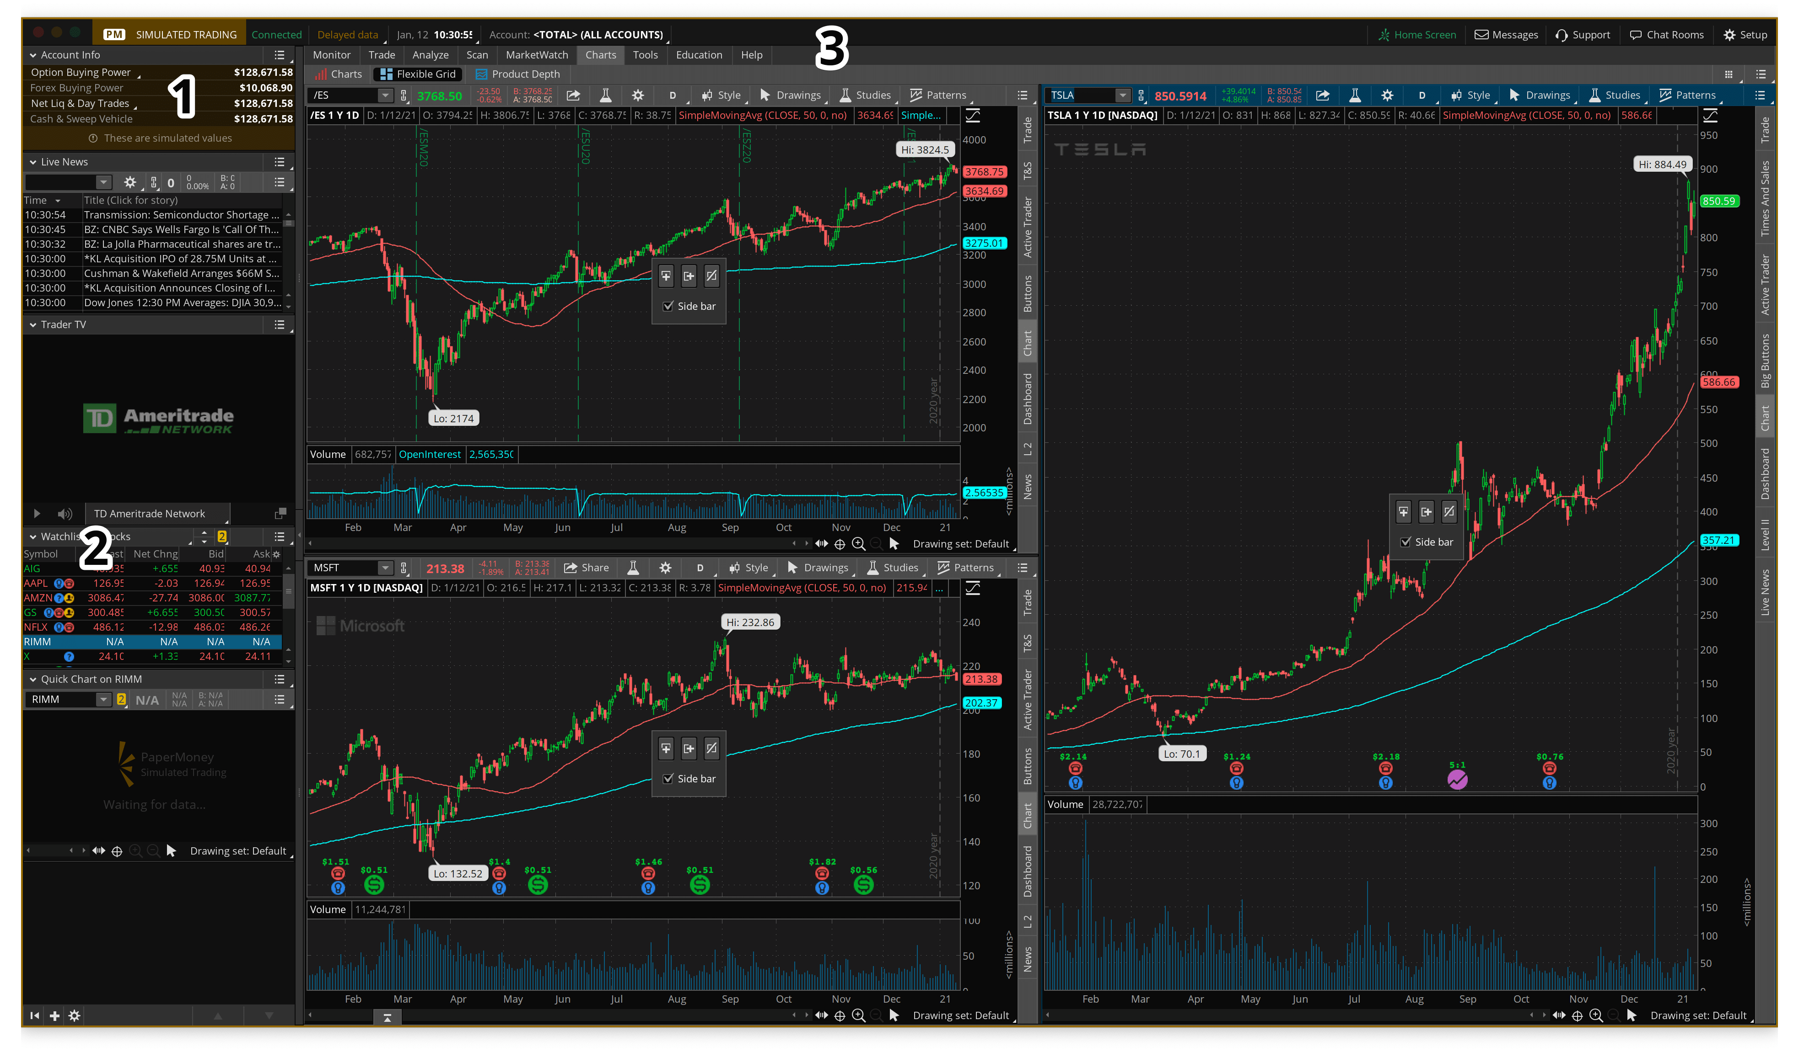
Investing: Expectations

Slide 3
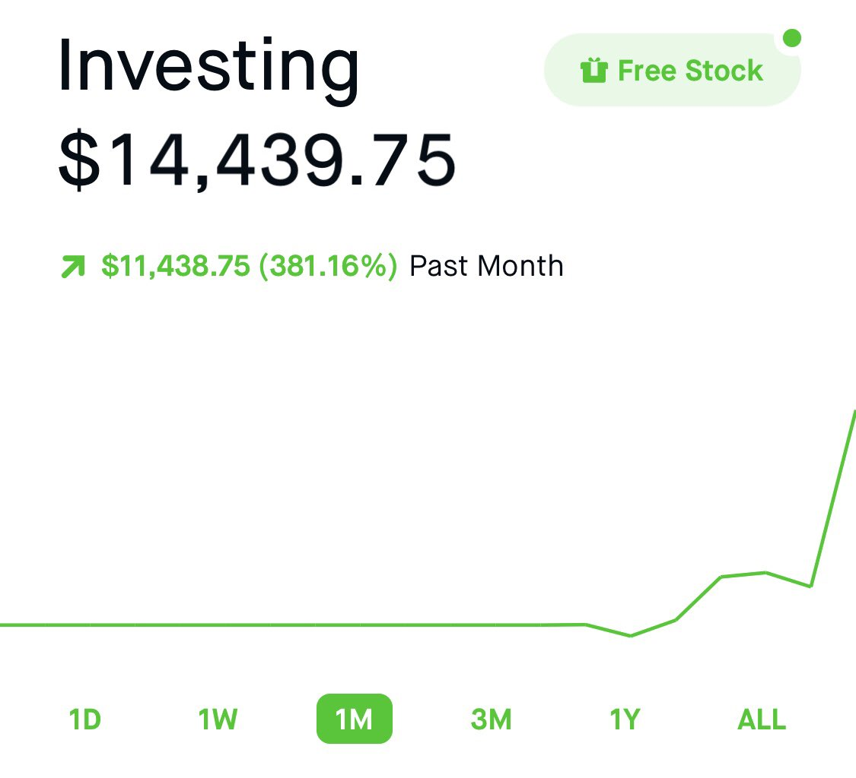
Investing: Expectations

Slide 4
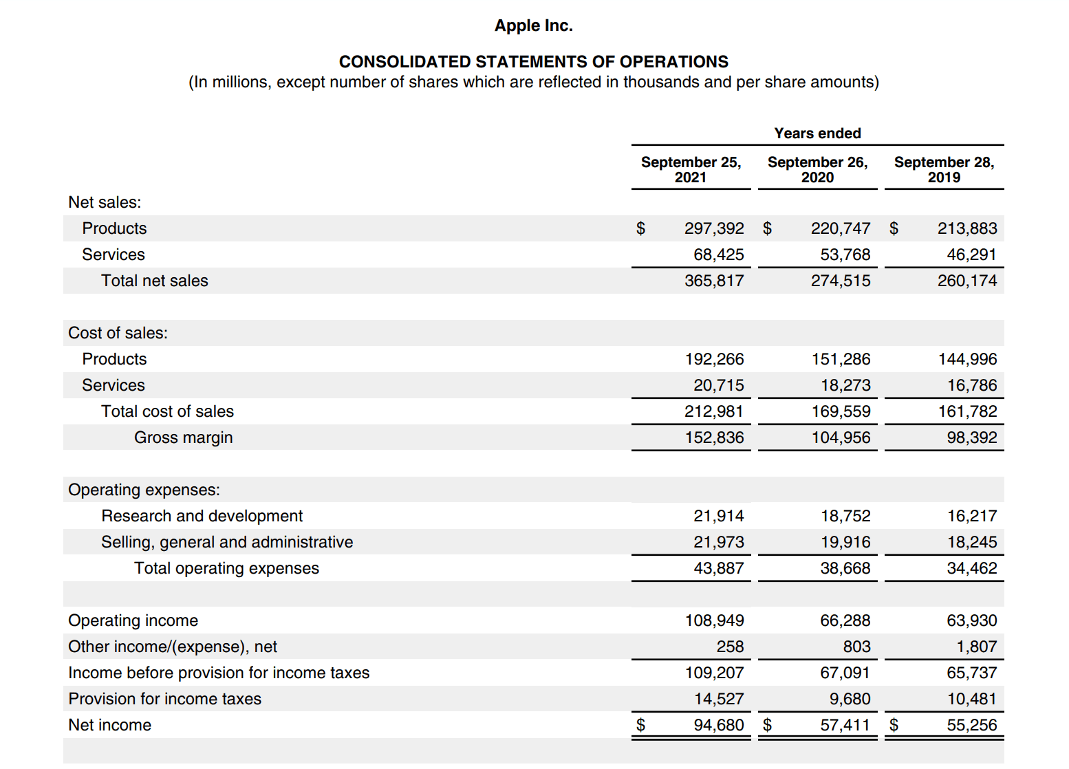
Investing: Reality

Slide 5
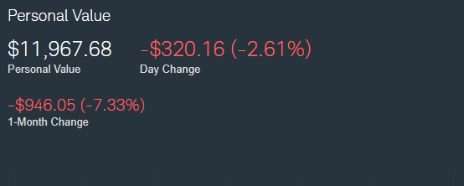
Investing: Reality

Slide 6
Investing: As a Student
Inundated with information about market constantly
Mainstream media
Transition of investment knowledge
What is right and what is wrong?
Million-dollar question
Where should you put your money?

Slide 7
Investing: Mentors
Really hard to figure out what to do without a mentor
Who can this be?
Parents
Other students
Coworkers
Pretty much anyone
Most important: No one knows the “right” answer

Slide 8
Mindset
Fear, Euphoria, Regret, Excitement, Hesitation, Uncertainty, Happiness
Emotions will run the gamut when investing
The price of playing poker
Rely on your mentors, remember it is a long term activity

Slide 9
My First Experience
Mentor: Brother of Tennis Coach
What I did: Bought 4 different stocks of his recommendation
What happened: I learned the emotions associated with investing and began to ask questions about what my money was doing
Why is this a good stock?
Is my money better elsewhere?
What about risk?
Mindset: I want to learn more

Slide 10
Stocks
A portion of a company
Buying a piece of the profits of a company
Portfolio performance relies on good stock selection, company fundamentals, and macroeconomic conditions
Picking can be stressful
Competitive (try to beat the market)

Slide 11
ETFs/Mutual Funds
A collection of stocks that is actively managed in set time periods
Usually created to represent a certain market or area
The U.S. Market, Industrials, Tech
Has associated fees for the management
Less risky due to diversification purposes (typically)

Slide 12
ETFs vs. Mutual Funds
Mutual Funds
Priced and traded once a day
Usually has a minimum entry fee (Ex. $3,000)
Usually more actively managed
ETFs
Priced and traded like a stock
No minimum entry fee
Usually pegged to an index

Slide 13
Brokerage Account
The account you need to trade stocks, ETFs, Mutual funds, etc.
Common ones: Fidelity, Charles Schwab, Robinhood, E*TRADE
For most people, really doesn’t matter which you choose

Slide 14
Conclusions
Knowing about investing and money is like knowing CPR, having a little bit of information can potentially reap huge rewards.

